Slide 1
INTERNSHIP REPORT&PROJECT REVIEW-1
INTERSHIP PERIOD : 29-05-2024 TO 30-07-2024
STUDENT NAME : K . CHINNI KRISHNA
ROLL NO : 21691A3708 IV CSE(CS)
REVIEW DATE : 19-11-2024
INTERNSHIP MENTOR : Mrs. A. KOMALA
I

Slide 2

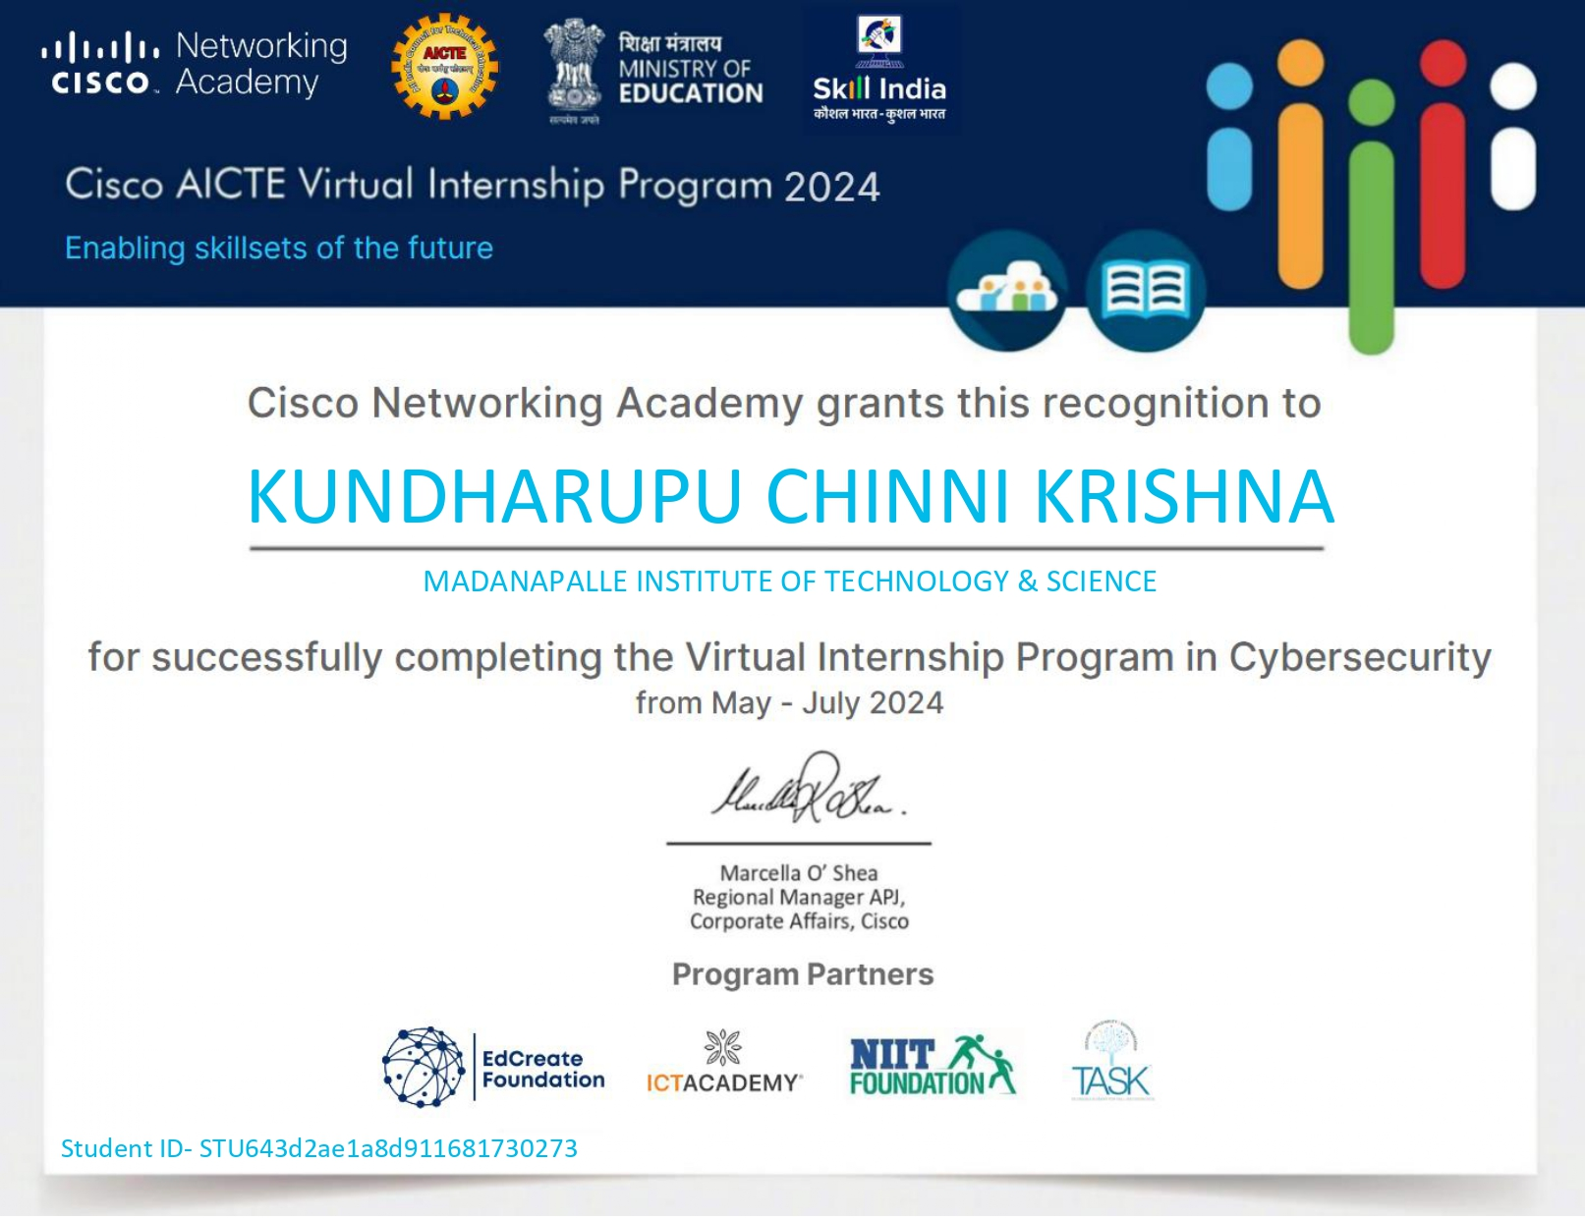
INTENSHIP CERTIFICATE

Slide 3

ABOUT ORGANIZATION DETAILS
Cisco Systems, Inc. is a leading multinational technology conglomerate based in San Jose, California, that develops, manufactures, and sells networking hardware, software, telecommunications equipment, and other high-tech products and services. Known for its significant contributions to internet and networking technology, Cisco plays a crucial role in connecting and securing the digital world.

Slide 4
Project Title:
File Data Secure Tool
using AES and DES

Slide 5
Things Learned
How to put my knowledge and skills into practice. ...
Understanding workplace culture. ...
Enthusiasm is invaluable. ...
Keeping a journal is great for personal growth. ...
How important good communication is. ...
The benefits of taking on feedback.

Slide 6
AGENDA
Introduction
Problem Statement
Project Overview
Results
Conclusion

Slide 7
Introduction
Image encryption and decryption are processes that protect image data by converting it into a secure format that conceals the original content, making it inaccessible to unauthorized users. This is especially important for sensitive images (e.g., medical scans, confidential documents, or personal photos) that need to be transmitted or stored securely.

Slide 8
Problem Statement
In the digital area, where images are extensively used and shared across various platforms, securing image data has become a significant challenge. Sensitive images, such as medical records, surveillance footage, military intelligence, and personal photos, are vulnerable to unauthorized access, tampering, and theft, particularly when transmitted over the internet or stored on third-party servers. Unauthorized access to these images can lead to severe privacy violations, data breaches, and potential misuse.
Traditional encryption methods, like text-based encryption algorithms, are often insufficient for handling images due to unique image characteristics, such as high data volume, redundancy, and correlation among pixels. Therefore, there is a need for specialized encryption and decryption techniques tailored for image data, which can secure images effectively while maintaining their integrity, ensuring that only authorized users can access the original image.

Slide 9
Project overview
Objective : The objective of this project is to design and implement a robust and efficient system for encrypting and decrypting image data. The system will ensure secure storage and transmission of sensitive images by converting them into an unreadable format, only reversible by authorized users with the correct decryption keys. This project targets high security while balancing efficiency, compatibility, and scalability.

Slide 10
Abstract
In today’s digital age, where images are frequently transmitted and stored on public and private networks, ensuring the security and privacy of sensitive image data has become paramount. Conventional encryption methods, often designed for text-based data, lack the robustness required to effectively secure images due to unique image properties like high data redundancy and inter-pixel correlation. The "Secure Image Encryption and Decryption System" project addresses this gap by designing a specialized encryption and decryption framework for images, aimed at protecting data integrity, privacy, and accessibility for authorized users only.

Slide 11
Advantages of image encryption and decryption
1. Data Confidentiality and Privacy
Encrypting images ensures that only authorized users with the correct decryption key can view the original image. This protects private or sensitive information, such as medical scans, financial documents, and personal photos, from unauthorized access.
2. Protection Against Unauthorized Access
Encryption protects images from unauthorized users by converting them into unreadable formats. Decryption restores the original image only for authorized users, ensuring controlled access to the image data and securing it even in cases of data breaches or unauthorized file access.

Slide 12
Disadvantages of image encryption and decryption
1. High Computational Overhead
Encryption and decryption processes, especially for high-resolution images, can require substantial computational power and processing time. This can slow down systems, particularly when handling large volumes of images or in real-time applications, like video streaming or live surveillance.
2. Increased Storage Requirements
Encrypted images often take up more storage space than unencrypted images due to the added complexity in the data structure. This can be a challenge for systems with limited storage capacity, leading to higher storage costs and additional resource requirements.

Slide 13

Outputs
Image Encryption:
Input Image

Slide 14

After Encryption the Key is generated with .key extention

Slide 15
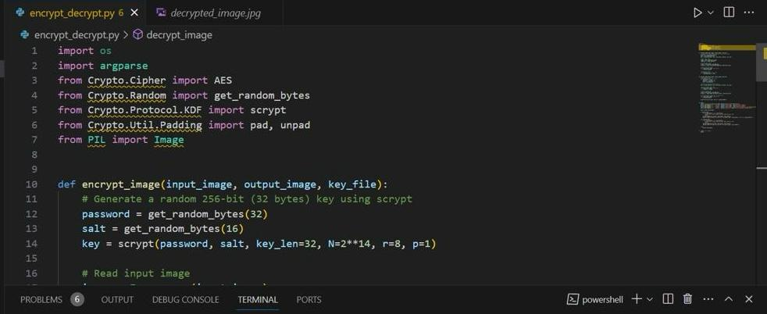
Image decryption:
After Decryption the Image is:

Slide 16
CONCLUSION:
Image encryption and decryption play a vital role in safeguarding sensitive image data in a wide range of applications, from personal privacy and cloud storage to fields like healthcare, finance, and national security. By transforming image data into an unreadable format, encryption ensures that only authorized users can access the content, protecting it from unauthorized access, tampering, and data breaches. Decryption allows this encrypted data to be converted back to its original form when needed, enabling secure data exchange and storage.

Slide 17


